Slide 1
Solving Programming Problems
A Seven-step Approach

Slide 2
Problem Solving/Solving Everyday Problems
Steps include:
Analysis
Planning
Review
Implementation
Evaluation
Modification

Slide 3
Creating Computer Solutions to Problems
Analyze the problem
Plan the algorithm
Desk-check the algorithm
Code the algorithm into a program
Desk-check the program
Evaluate and modify (if necessary) the program

Slide 4
Analyzing the Problem
Purpose of analyzing problem:
to determine the goal
to determine the items needed to achieve goal
to develop a problem statement

Slide 5
Seven Steps
1
Work Example By Hand
2
Write Down What You Did
3
Find Patterns
4
Check By Hand
5
Translate To Code
6
Run Test Cases
7
Debug Failed Test Cases

Slide 6
Seven Steps
1
Work Example By Hand
2
Write Down What You Did
3
Find Patterns
4
Check By Hand
5
Translate To Code
6
Run Test Cases
7
Debug Failed Test Cases
Analyze the problem before starting the above steps
Planning the algorithm is 1, 2, 3
Desk-check the algorithm is 4
Code the algorithm into a program is 5
Desk-check the program is 6
Evaluate and modify is 7

Slide 7
Step 1
1
Work Example By Hand
2
Write Down What You Did
3
Find Patterns
4
Check By Hand
5
Translate To Code
6
Run Test Cases
7
Debug Failed Test Cases
Solve a small problem by hand
Difficulties caused by:
Unclear Problem
Lack of domain knowledge

Slide 8
Step 2
1
Work Example By Hand
2
Write Down What You Did
3
Find Patterns
4
Check By Hand
5
Translate To Code
6
Run Test Cases
7
Debug Failed Test Cases
Write down exact steps
Just that instance
Tricky: do without thinking

Slide 9
Step 3
1
Work Example By Hand
2
Write Down What You Did
3
Find Patterns
4
Check By Hand
5
Translate To Code
6
Run Test Cases
7
Debug Failed Test Cases
Algorithm for any instance
Find patterns
Repetition, conditions, values

Slide 10
Step 3
1
Work Example By Hand
2
Write Down What You Did
3
Find Patterns
4
Check By Hand
5
Translate To Code
6
Run Test Cases
7
Debug Failed Test Cases
Difficulties?
Try Step 1 and 2 again
Different inputs

Slide 11
Step 4
1
Work Example By Hand
2
Write Down What You Did
3
Find Patterns
4
Check By Hand
5
Translate To Code
6
Run Test Cases
7
Debug Failed Test Cases
Incorrect pattern? Find now
Check with different inputs

Slide 12
Step 5
1
Work Example By Hand
2
Write Down What You Did
3
Find Patterns
4
Check By Hand
5
Translate To Code
6
Run Test Cases
7
Debug Failed Test Cases
Translate algorithm to code
Programming language

Slide 13
Step 6
1
Work Example By Hand
2
Write Down What You Did
3
Find Patterns
4
Check By Hand
5
Translate To Code
6
Run Test Cases
7
Debug Failed Test Cases
Run test cases on code
Execute program
Check answer

Slide 14
Step 7
1
Work Example By Hand
2
Write Down What You Did
3
Find Patterns
4
Check By Hand
5
Translate To Code
6
Run Test Cases
7
Debug Failed Test Cases
Test failed? Debug
Use scientific method
Understand problem + fix

Slide 15
Step 7
1
Work Example By Hand
2
Write Down What You Did
3
Find Patterns
4
Check By Hand
5
Translate To Code
6
Run Test Cases
7
Debug Failed Test Cases
Algorithmic problem?
Implementation problem?

Slide 16
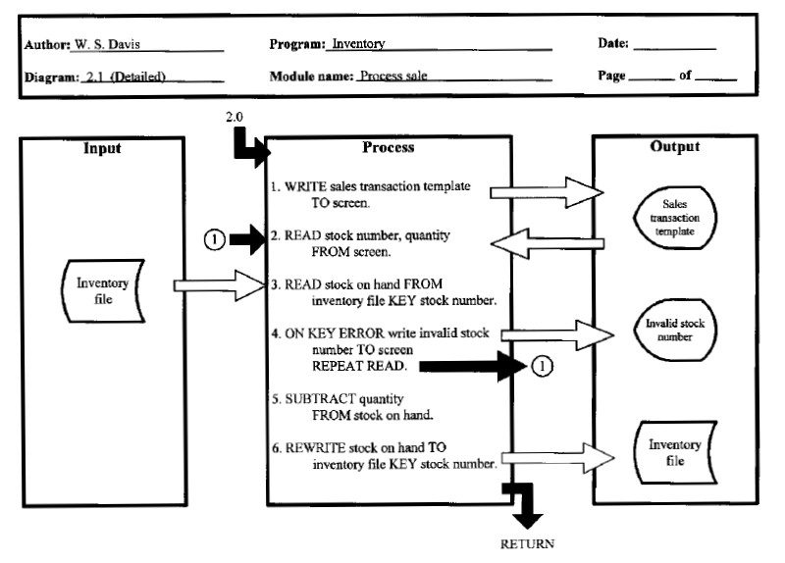
Input-Process-Output (IPO) Chart
An IPO chart shows the input data, the process that the data will undergo, and the end result

Slide 17
Input-Process-Output (IPO) Chart
IPO Chart can be done for the entire program or for individual functions
Could be done after step 4 of the seven step process or simultaneously while doing steps 2 through 4.

